Slide 1
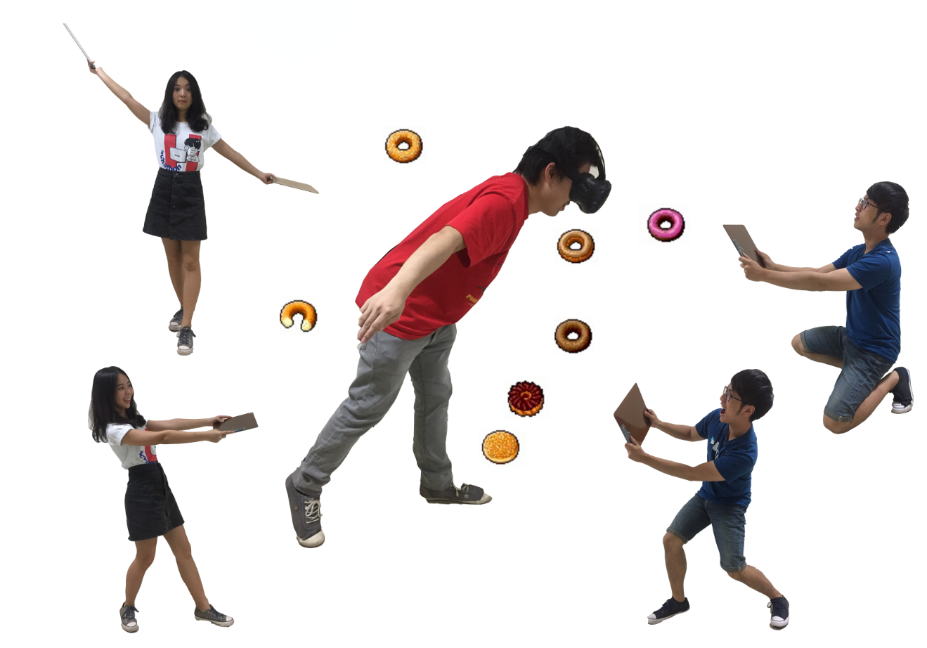

Slide 3
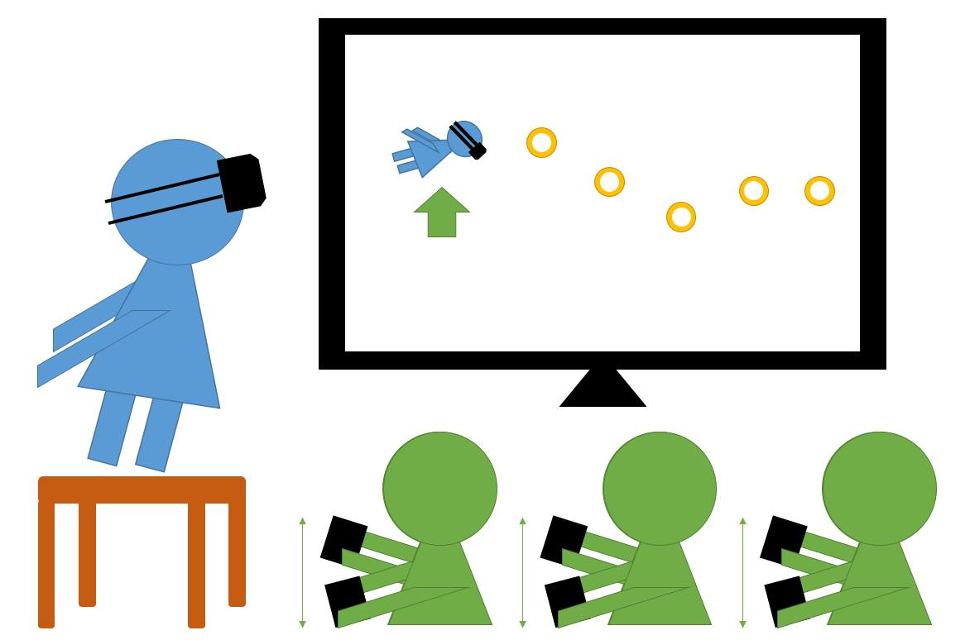

Slide 5
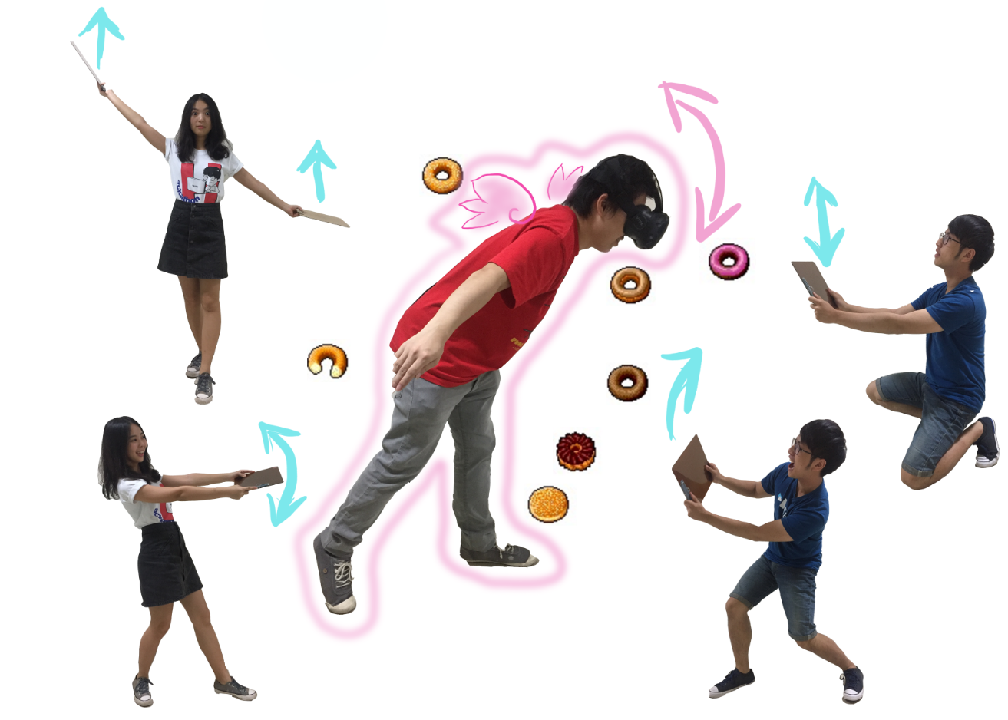

Slide 6
More possibilities:
Spectators collaborate with each other
Heat and vibration
Wind (fan)

